Slide 1
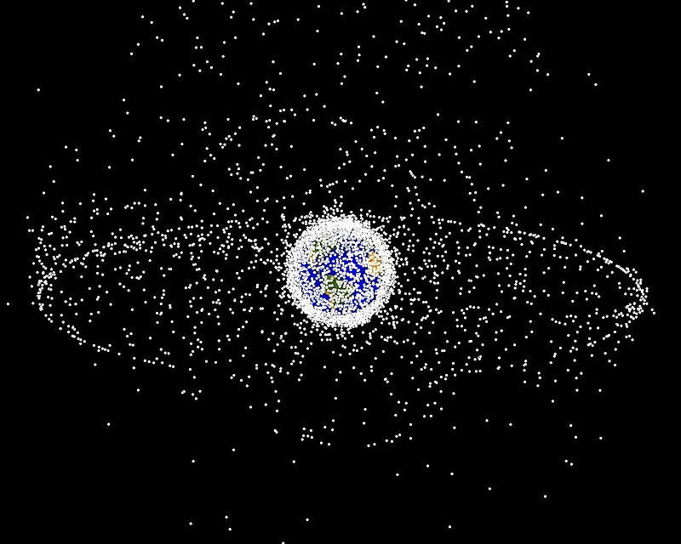
Modelling and Simulation of Kessler Syndrome in Low Earth Orbit
A determination of critical densities, time to tipping point, and risk after tip
Nasa Orbital Debris Program Office

Slide 2
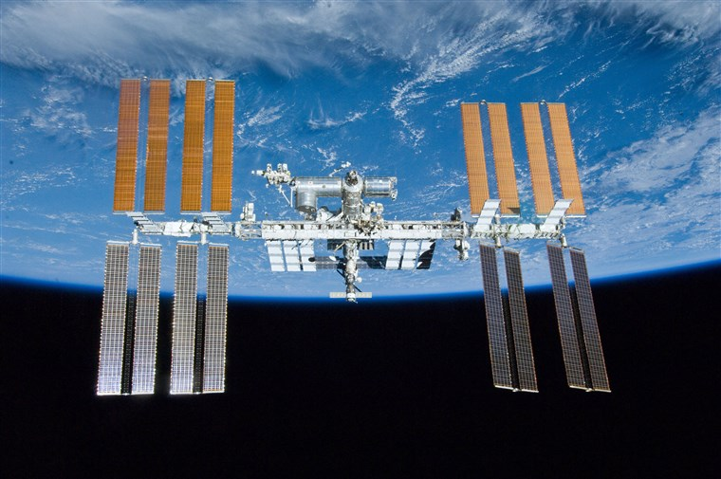
Problem Statement
When will Kessler Syndrome render LEO too risky for manned space stations?
When will it be too risky to manned spaceflight of any kind?
How will removal methods and satellite/debris densities interact with this risk?

Slide 3
Scope and Requirements
Create or adapt a simulation environment that can model
Simple collisions between objects
Removal methods (laser broom, netting or tentacle methods)
The density of debris in space over time, as described in current literature
Additional satellite launches over the next 10 years, as described in literature
Danger of collision for a specific object in LEO over a specific amount of time

Slide 4
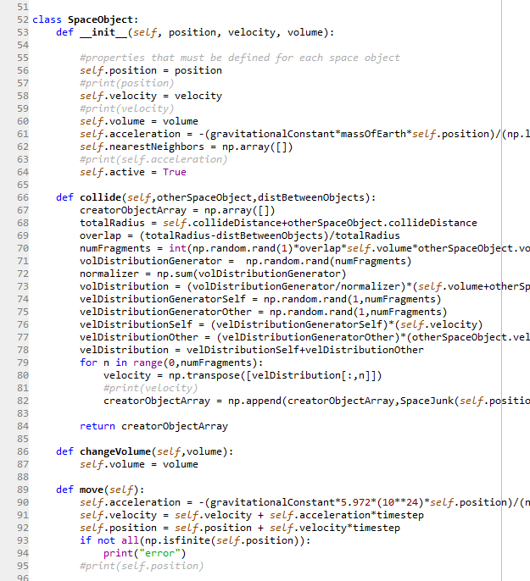
Challenges
Began with object-oriented Python model
Quite beautiful
Fully functional
Took ~3 seconds per tick of sim
Need ~10 ticks per second for reasonable accuracy
Not able to reduce times significantly

Slide 5
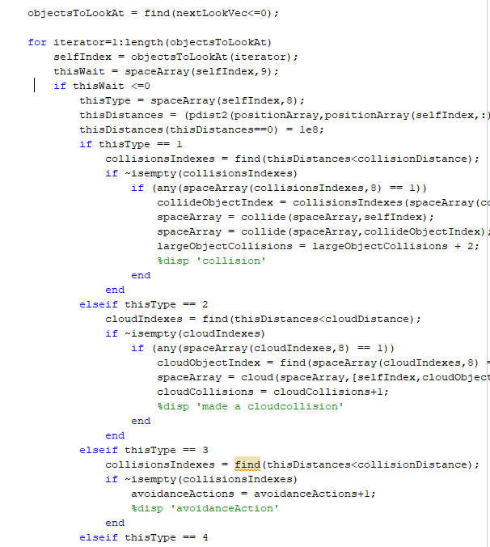
More Challenges
Moved to MATLAB
Abandoned object-orientation
Took advantage of linear algebra benefits
Still too slow
Also, too high-memory (16 gigabyte distances matrix)
Abandoned full distance matrix
Developed skipping algorithm

Slide 6
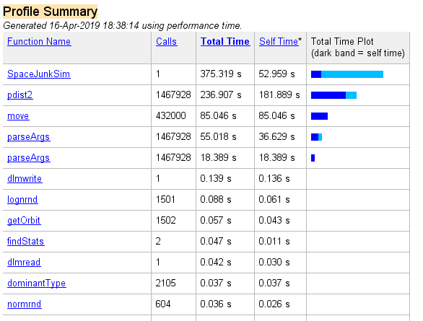
Challenges Resolved
Now, sim takes less than a thousandth of a second per tick
Approximately 48 hours of computation time for 6 months of simulation

Slide 7
Finished Model
Smallest, most frequent dots are inactive satellites
Medium, blue dots are junk clouds
Large blue dots are active satellites
Other dots are cleaners

Slide 8
Verification
Code compiles
All functions within code are reached under appropriate option conditions
Wait times always > 0 and within reason
Visualizations of the orbits make sense, and agree with published models

Slide 9

Validation
Seed data agrees with known collision rates and the experiences of the ISS
Laser effects agree with published laser data
Cloud assumption results in behaviors consistent with published data for Iridium-Cosmos collision
Number of collisions between large objects per unit time is reasonable (~1/6 months)
Results are within rational bounds

Slide 10
Design of Experiments
Time (Days) | Satellites clean clouds? | Satellite Launch Rates | Cleaner Satellites | Laser Brooms
25 | 1 | 3456000 | 2 | 1
25 | 1 | 864000 | 1 | 1
25 | 1 | 864000 | 0 | 0
25 | 1 | 4752000 | 1 | 0
25 | 0 | 6048000 | 2 | 0
25 | 0 | 6048000 | 1 | 1
25 | 1 | 6048000 | 3 | 1
25 | 0 | 6048000 | 3 | 1
25 | 1 | 2160000 | 0 | 1
25 | 1 | 864000 | 2 | 0
25 | 0 | 4752000 | 0 | 0
25 | 0 | 4752000 | 2 | 1
25 | 1 | 6048000 | 3 | 0
25 | 0 | 2160000 | 1 | 1
25 | 1 | 2160000 | 3 | 0
25 | 0 | 2160000 | 2 | 0
25 | 1 | 6048000 | 1 | 1
25 | 1 | 6048000 | 0 | 0
25 | 1 | 4752000 | 2 | 1
25 | 0 | 3456000 | 1 | 0
25 | 0 | 864000 | 2 | 0
25 | 1 | 2160000 | 3 | 1
25 | 0 | 4752000 | 0 | 1
25 | 0 | 2160000 | 2 | 1
25 | 0 | 864000 | 0 | 1
25 | 0 | 864000 | 0 | 0
25 | 0 | 864000 | 3 | 1
25 | 0 | 4752000 | 3 | 0
Limited inputs
That’s how it is
Response Surface
Expected to be reasonably linear
Long computation times

Slide 11
Results

Slide 12
Conclusions

Slide 13
Citations
Donald J. Kessler et al. THE KESSLER SYNDROME: IMPLICATIONS TO FUTURE SPACE OPERATIONS. 2010
R L Phipps, K & B Baker, S & A Libby, D & S Liedahl, S & D Olivier, L & Pleasance, A & E Rubenchik, J & V Trebes, E & George, B & P Marcovici, Reilly & Phipps, Claude & L Baker, Kevin & Libby, Stephen & A Liedahl, Duane & Olivier, Scot & D Pleasance, Lyn & Rubenchik, Alexander & E Trebes, James & T Valley, Michael. (2012). Removing Orbital Debris with Pulsed Lasers. AIP Conference Proceedings. 1464. 10.1063/1.4739901.
H. Hakima and M. R. Emami, "Prioritizing orbital debris for active debris removal missions," 2017 IEEE Aerospace Conference, Big Sky, MT, 2017, pp. 1-11. doi: 10.1109/AERO.2017.7943788 URL: http://ieeexplore.ieee.org/stamp/stamp.jsp?tp=&arnumber=7943788&isnumber=7943554
Ireland, S. (2010). Dodging bullets: The threat of space debris to U.S. national security (Unpublished master's thesis). Thesis / Dissertation ETD.
(Others omitted for brevity, but available on request).

